Slide 1
Program Structure and Code Conventions
C# Coding Standards and Best Programming Practices
20/03/2014 by L.Klakovych
10/03/2016 Edited by N.Pylyp
10/03/2016 Reviewed by R.Yakhymets

Slide 2
Introduction
The goal of this lecture is to provide a standard coding technique for C#. Net projects hold by the members of MS Solutions team.
The techniques defined here are not proposed to form an inflexible set of coding standards. They are rather meant to serve as a guide for developing a coding standard for a specific software project.

Slide 3
Agenda
General rules
File Organization
Namespaces.Classes. Interfaces.
Methods. Properties. Fields. Local Variables
Events and Delegates
Enum Naming Guidelines
Comments
Exception Handling
Format. Case study

Slide 4
General rules
1.1. General rules
“A name should tell ‘what’ rather then ‘how’.
Long enough to be meaningful - short enough to avoid verbosity.
Must be comprehensible by reader .
Avoid redundant class names while naming properties and methods
List.ListItem should be named List.Item
Fully usable from both case-sensitive and case-insensitive languages. Don’t create namespaces, class names, property names, method names, parameters names etc. that differ only by case.
Avoid using class names that duplicate .NET Framework namespaces: System, Collections, Forms, UI, etc.

Slide 5
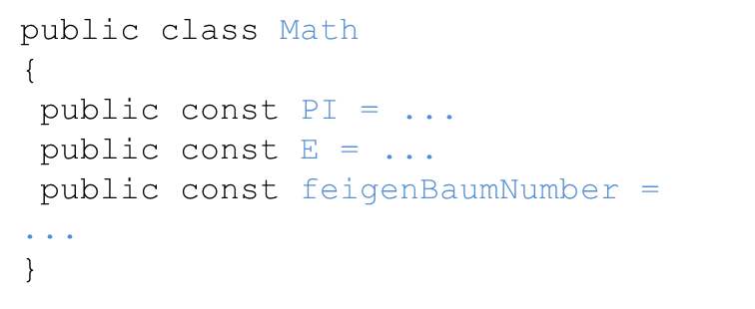
General rules
1.2. Capitalization Styles:
Pascal Casing - capitalize the first character of each word
TestCounter, Item, GroupName
Camel Casing - capitalize the first character of each word except the first one.
testCounter, name, firstName
Upper case - only use all upper case for identifier-abbreviation of 1 or 2 characters. Identifiers of more then 3 characters should use Pascal Casing instead.

Slide 6
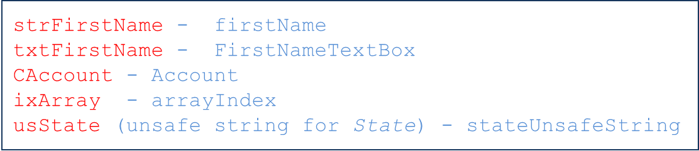
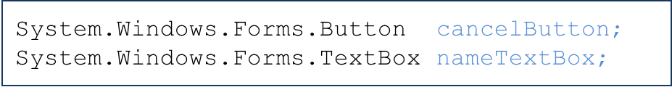
General rules
1.3. Hungarian notation
Is a defined set of pre and postfixes to names to reflect the type of the variable. Using Hungarian notation is not allowed.
An exception to this rule is GUI code:

Slide 7
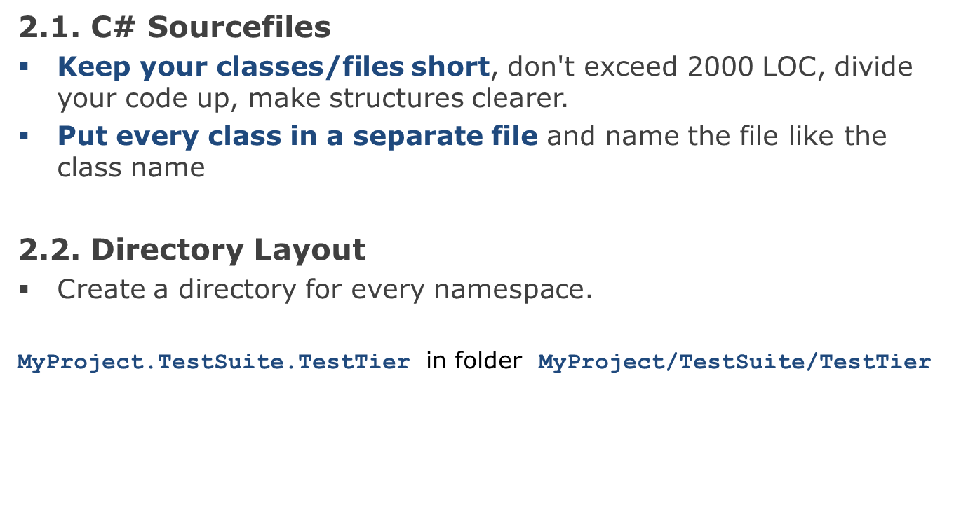
File Organization

Slide 8
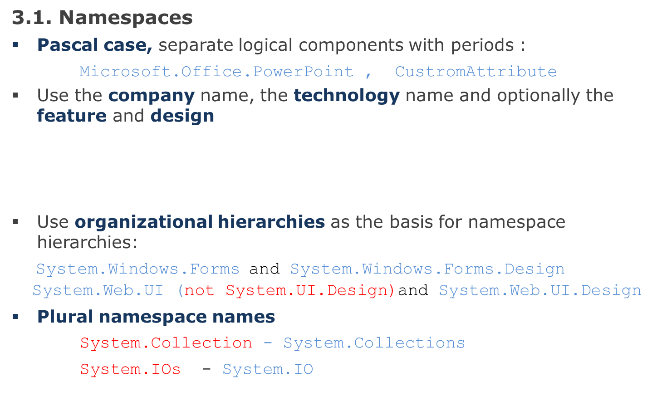
Namespaces
CompanyName.TechnologyName[.Feature][.Design]
Baseshop.Media
Baseshop.Media.Design

Slide 9
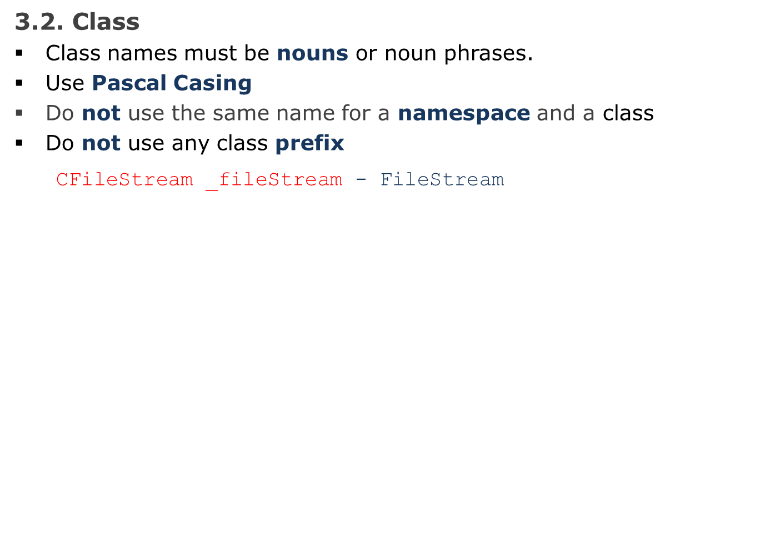
Classes names

Slide 10
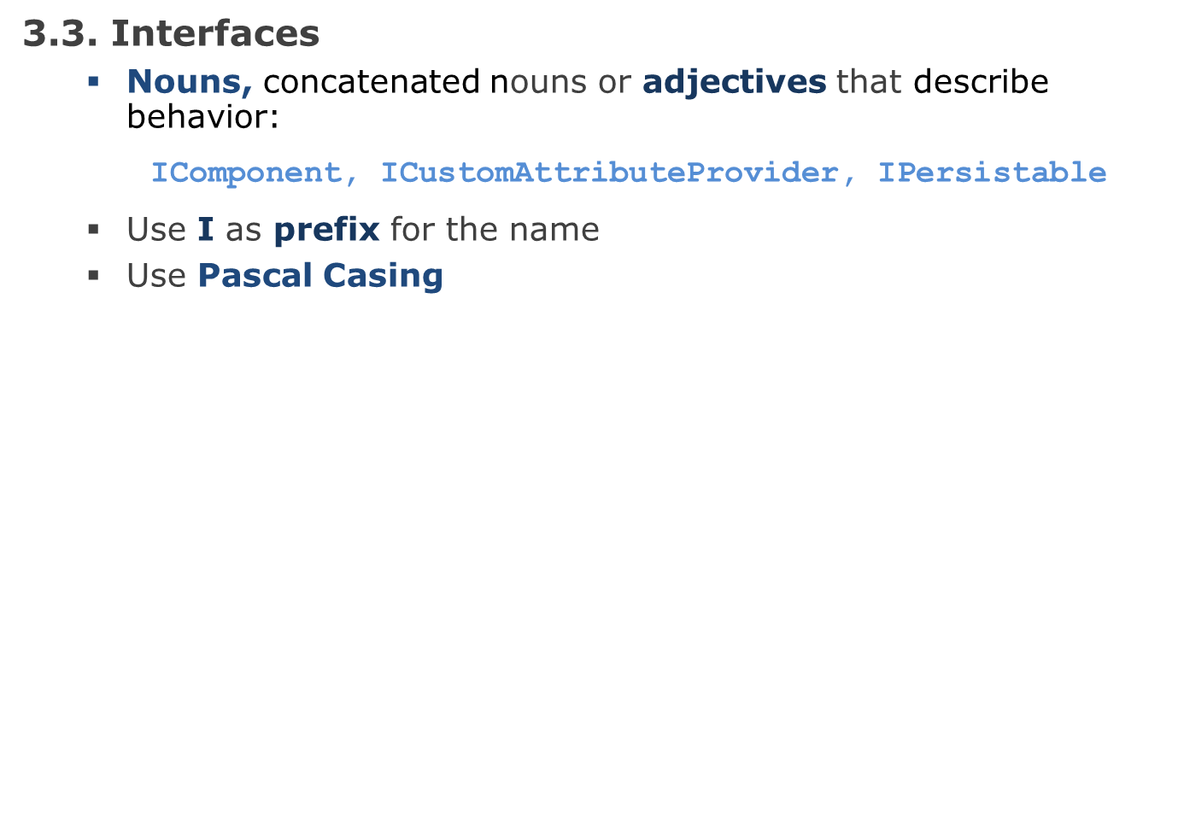
Interfaces names

Slide 11
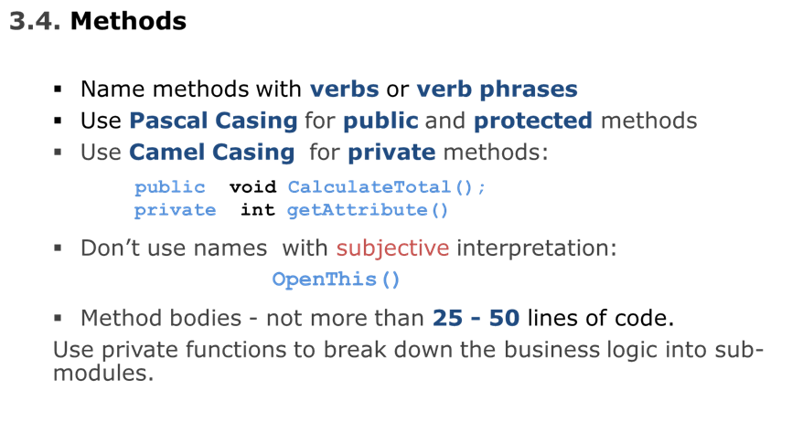
Methods names

Slide 12
Methods. Best practices
Make the method name obvious
Good:
public void SavePhoneNumber (string phoneNumber)
{
// Save the phone number.
}
Not good:
// This method will save the phone number.
void SaveData (string phoneNumber)
{
// Save the phone number.
}

Slide 13
Methods. Best practices
A method should do only "one job".
Good:
// Save the address.
SaveAddress (address);
// Send an email to the supervisor to inform that the address is // updated.
SendEmail (address, email);
public void SaveAddress (string address)
{
// Save the address.
// ...
}
public void SendEmail (string email)
{
// Send an email to inform the supervisor that the address // is changed.
}
Not good:
// Save address and send an email to the supervisor
// to inform that the address is updated.
SaveAddress ( address, email );
void SaveAddress ( string address, string email )
{
// Job 1. Save the address.
// Job 2. Send an email to inform the supervisor
}

Slide 14
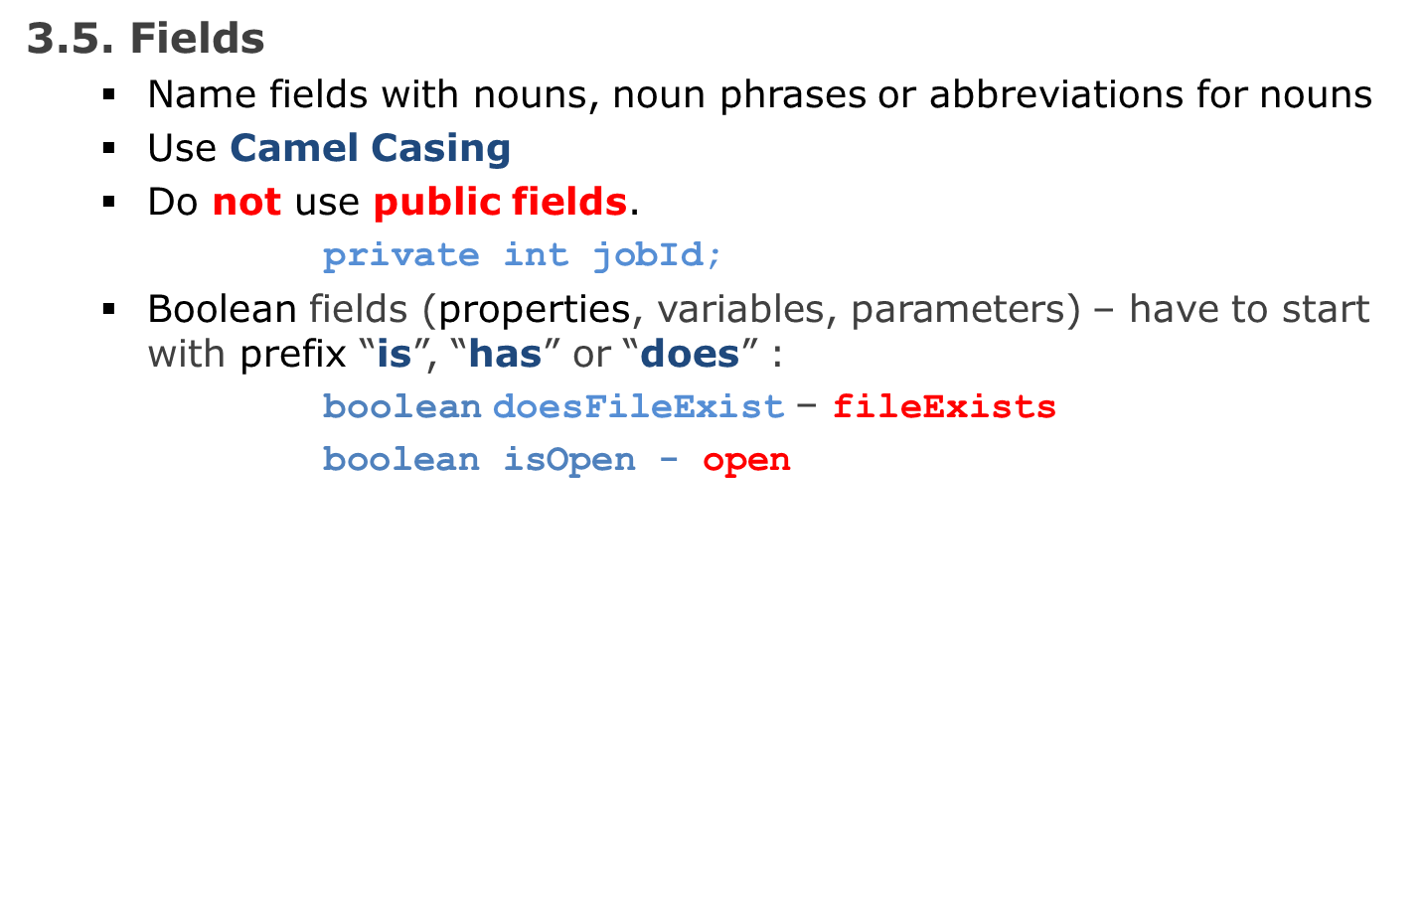
Fields names

Slide 15
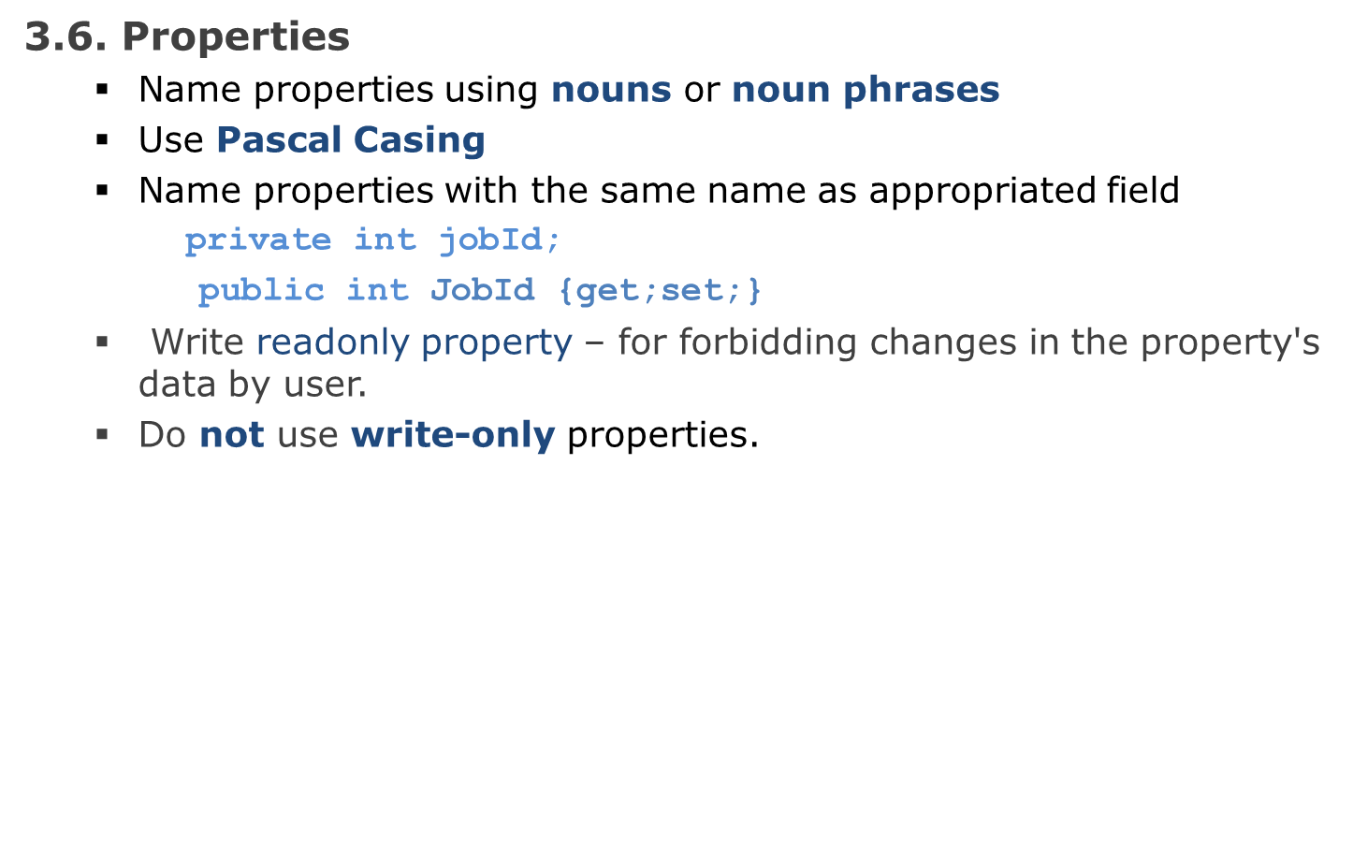
Properties names

Slide 16
Local variables
3.7. Local variables and parameters
Use Camel casing
Even for short-lived local variables use a meaningful name.
Exceptions: ‘i’, ‘j’, ’k’, ’l’, ’m’, ’n’ - for loops variables;
‘x’, ‘y’, ‘z‘ - for coordinates;
‘r’, ‘g’, ‘b’ - for colors;
‘e’ - for event argument.
Avoid magic numbers: named constants in conditions instead of numbers (exceptions: 0, 1, –1):
for(i = 0; i < NumDaysInWeek; i++)
instead of
for(i = 0; i < 7; i++);

Slide 17
Local variables
Avoid using hard coded strings for messages that are displayed to user. Use a named constant, a database record or resource file item instead.
Use formatted strings instead building strings for custom messages :
DeleteMessage = "File {0} deleted.";
. . .
res = String.Format (DeleteMessage, drawFile.Name);

Slide 18
Events. Delegates
3.8. Events. Delegates
Name event handlers with the EventHandler suffix.
Two parameters: sender and e.
sender - object type, represents the object that raised the event, if it is possible to use a more specific type.
e – encapsulates the state associated with the event. Type - appropriate and specific event class.
Use Pascal Casing
Name event argument classes with the EventArgs suffix.
Consider naming events with a verb.
Name event that have a concept of pre and post using the present and past tense.
Do not use a prefix or suffix in the event declaration:
Close instead of OnClose

Slide 19
Events. Delegates
Remember about unsubscribing from events.
public delegate void ColorEventHandler(object sender, ShapeEventArgs e);
public event ColorEventHandler ColorChanged;
Circle.ColorChanged += new Shape.ColorEventHandler(CircleColorChanged);
Circle.ColorChanged -= CircleColorChanged;

Slide 20
Enum
3.9. Enum
Use Pascal Casing for enum value names and enum type names
Don’t prefix (or suffix) enum type or enum values
Use singular names for enums
Use plural name for bit fields.
public enum StatusMode
{
Planned = 1,
Active = 2,
InActive = 4,
All = 7
};

Slide 21
Enum
Use enum instead using numbers or strings to indicate discrete values.
Not good:
Good:
enum MailType {Html, PlainText, Attachment}
public void SendMail (string message, MailType mailType)
{
switch (mailType)
{
case MailType.Html:
// Do something
break;
case MailType.PlainText:
// Do something
break;
case MailType.Attachment:
// Do something
break;
default:
// Do something
break;
}
}
void SendMail (string message, string mailType)
{
switch ( mailType )
{
case "Html":
// Do something
break;
case "PlainText":
// Do something
break;
case "Attachment":
// Do something
break;
default:
// Do something
break;
}
}

Slide 22
Comments
4.1. Single Line Comments
Use complete sentences when writing comments.
Comments should be quite informative and understandable by other people
Always keeps the commenting up to date (actual).
Avoid adding comments at the end of a line of code (except local variable declarations)
Use comments on important loops and logic branches.
Comment all private field declarations (// ).
Block comments should usually be avoided.
/* Line 1
* Line 2
* Line 3
*/
int level; // indentation level
int size; // size of table

Slide 23
Comments
4.2. XML Documentation
In the .Net framework is a documentation generation system based on XML comments.
At the beginning of every construction part of code (class, method, property, function or protected field declaration, etc.) use “<summary>” XML commenting tag (type “///” for automatically generation)
Provide descriptions of parameters and return value of methods and functions in the corresponding tags.
Documentation can be generated using the 'documentation' item in the #develop 'build' menu. The documentation generated is in HTMLHelp format.
/// <summary>
/// Checks that stored procedure exists in the database
/// </summary>
/// <param name="stProcName">Name of the stored procedure</param>
/// <returns>true if the procedure exists</returns>
public bool CheckSPExists (string stProcName)
{
. . .
}

Slide 24
Exception Handling
5.1. Exception handling. Best practices
Never do a "catch exception and do nothing.”
Give a friendly message to the user, but log the actual error with all possible details about the error, including the time it occurred, the method and class name, etc.
Catch only the specific exceptions, not generic exceptions.
Exceptions should be handled from more specific to less specific (e.g. SQLException first and then general exception).
Don’t catch general exceptions in all your methods.
Don’t write try-catch in all your methods. For example, if you are writing into a file, handle only FileIOException.
Do not write very large try-catch blocks.
You may write your own custom exception classes in your application.
Don’t derive your custom exceptions from the base class SystemException. Instead, inherit from ApplicationException

Slide 25
Exception Handling
Not Good:
void ReadFromFile (string fileName)
{
try
{
// read from file.
}
catch (Exception ex)
{
// Catching general exception is bad...
// we will never know whether it
// was a file error or some other error.
// Here you are hiding an exception.
return "";
}
}

Slide 26
Format
Establish and use a standard size for an indent through the project.
Default indent - tab size (4 space characters).
Line of code - less than 80 characters
Align open and close braces vertically :
for (i = 0; i < NUMOBJECT; i++)
{
. . .
}
Indent code along lines of logical construction:
if (reportId != BaseTable.INVALIDPK)
{
try
{
recReport = RepManager.GetRecordByPK(reportId);
}
catch (Exception ex)
{
HandleException(ex);
}
}
else
{
recReport = new RecReports();
}
for (…) {
. . .
}

Slide 27
Format
Break long statement it to several lines and use double indenting in next lines.
if (Member.Address.Room != null && Member.Address.Room != "" &&
(Member.Address.Sect > 0 || Member.Address.BuildNo > 0))
Member.Address.Normalize();
Break long statement with logical code structure.
Wrong formatting:
if (Address.Room != null && Address.Room != "" && (Address.Sect
> 0 || ((Address.BuildNo != null && Address.BuildNo !=
"")?Address.BuildNo:DEFAULT_BUILDING_NO) > 0) &&
Address.IsNotPrepared)
Member.Address.Normalize();

Slide 28
Format
Correct
if (Address.Room != null && Address.Room != "" &&
(Address.Sect > 0 ||
((Address.BuildNo != null && Address.BuildNo != "")?
Address.BuildNo:DEFAULT_BUILDING_NO) > 0) &&
Address.IsNotPrepared)
Member.Address.Normalize();
Good
if ( ... )
{
// Do something
. . .
}
Not good
if ( ... ) {
// Do something
. . .
}

Slide 29
Format
Use a single space before and after each operator and brackets.
Good:
if (showResult == true)
{
for ( int i = 0; i < 10; i++ )
{
// . . .
}
}
Not good:
if(showResult == true)
{
for(int i = 0; i < 10; i++)
{
// . . .
}
}

